Slide 1


Slide 2


Porting Unity to new APIs Aras Pranckevičius Unity Technologies

Slide 3
Warm up quotes!
“I expect DX12 to give people an appreciation for what DX11 was doing for them” (Tom Forsyth)
“Low-level graphics APIs are built for engine developers, not humans” (Tim Sweeney)
“GL -> Vulkan is like complaining that your Prius is too slow, so someone gives you all the pieces of a Ferrari” (Brandon Jones)
Notes:
https://twitter.com/TimSweeneyEpic/status/628713913094422528
https://twitter.com/tom_forsyth/status/628751206492569601
https://twitter.com/Tojiro/status/628664374408839169

Slide 4
New APIs are easy when…
You’re starting a new engine now, or
Have a good console engine, or
You have no customers, or
It’s a hobby/toy engine, or
Somehow made all the right decisions 10 years ago

Slide 5
Bending an existing engine
Naïve change to use new APIs
Shader languages (only Metal & Vulkan)
Resource bindings (only DX12 & Vulkan)
Threaded work creation
…sync, mem alloc, etc. (won’t cover those)

Slide 6
Naïve porting
Same engine, same structure, same ideas
Just get to whatever you had in DX11/DX9/GL
Metal:
Much less code than in GLES ☺
Much faster than iOS GLES ☺
DX12:
Similar amount of code to DX11
Much slower than DX11 ☹☹☹
Notes:
GfxDevice (our “graphics platform abstraction”) implementation sizes in Unity right now (~5.3), so not reflecting the “initial port” state.
OpenGL + ES 727kb (does all GL/ES versions, and this includes all the functions/extensions loading code)
D3D11 474kb (quite some related to WSA/WP8, and DX11 bytecode massaging)
D3D12 364kb D3D9 231kb Legacy GL 231kb (dekstop GL 2.0-2.1, will go away soon)
Metal 132kb

Slide 7
Shading languages

Slide 8
What we have
DX12: HLSL
No problem. Same as DX11.
Metal: MetalSL
Nice language, but no one else uses it.
Cross-compile (currently: glsl-optimizer)
Vulkan: SPIR-V
“bytecode”; will have GLSL -> SPIR-V tools.
Notes:
Our current messy pipeline:
HLSL is the source language
We also do some code analysis / generation (Unity surface shaders); that is a combination of Cg 2.2 and MojoShader.
D3D9/11/12: use d3dcompiler_xx.dll
GL2, GLES2: HLSL -> (hlsl2glslfork) -> GLSL -> (glsl-optimizer) -> GLSL
GL3/4, GLES3: HLSL -> (hlslcc) -> GLSL
Metal: HLSL -> (hlsl2glslfork) -> GLSL -> (glsl-optimizer) -> MetalSL
Vulkan: ???

Slide 9
What we want
HLSL -> SPIR-V, possibly built on clang
Analysis / codegen / upgrade / refactor tools there
Extend HLSL as needed (towards C++/MetalSL like language?)
SPIR-V -> LLVM -> SPIR-V xplatform optimizer
Platform backends: SPIR-V to...
HLSL/PSSL (D3D9/11/12, XB1, PS4 etc.)
GLSL (GL/ES)
MetalSL (Metal)
Notes:
HLSL is not ideal shading / compute language, but there’s massive, massive amount of shader code written in it already.
We’d want that to continue working :)
Eventually we’d want to move towards something like MetalSL, where it’s basically a C/C++ subset (no virtuals, no exceptions etc.), but extended for GPU specific things with various annotations.

Slide 10
Resource Bindings

Slide 11
Why so slow?
Initial DX12/Vulkan port will not run fast
Lots of “late” decisions
e.g. at Draw time, “so what has changed? which tables need update?” etc.
That is the “driver cost”! But drivers were heavily optimized already. Your new code is not.

Slide 12
APIs assume that…
You have a lot of knowledge
Which things change and when
Which things don’t change
Layouts of shader resources / constants
Ideally you have that knowledge!
Your existing code might not (yet)

Slide 13
Example
Constant/Uniform buffers
actually started a while ago in DX10/GL3
Ideal use case: shader CB matches C struct
Works if engine & shaders are developed in sync
We don’t have this luxury :(
People can be on latest Unity, and use shaders written 3 years ago
No clear fit into ideal CB/UB model!

Slide 14
More assumption examples
Similar now with DX12 descriptor tables
“you can prebuild a lot of static ones upfront”
Or with Pipeline State Objects
“you know final PSO state quite early on”
In current Unity code that’s not quite true
…yet ☺

Slide 15
Resource Binding, Now
Descriptor tables (DX12) & CBs (DX12/Metal):
Linearly allocate
Mostly one-time use only
Essentially everything is treated as dynamic data

Slide 16
Resource Binding, Soon
“per draw” vs “everything else” frequencies
Fast path when shader data matches what code knows about
Generic “it works” code otherwise

Slide 17
Threaded work creation

Slide 18
Threaded Work Creation
Command buffer “creation” and “submission” separate
Can create from multiple threads!
Just like some consoles could for a while ☺

Slide 19
Current rendering (Unity 5.2)
Dual-thread
MainThread: high level render logic
RenderThread: does API calls and a bit more
Ringbuffer with our own “command buffer” in between
Works on all platforms/APIs
…except WebGL since no threads there yet

Slide 20
Threading the renderer
Just make rendering logic etc. be freely threadable
Turns out: quite a lot of mutable/global state ☹
e.g. “I’ll just have a small cache here”
make it per-thread cache?
thread-safe cache?
stop caching?
do something else?
and so on

Slide 21
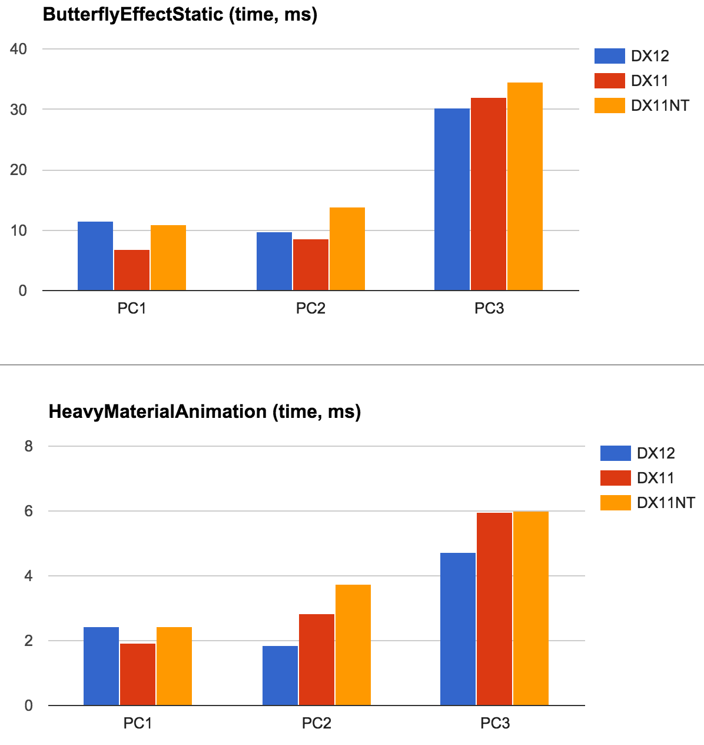
Current DX12 situation
Unity 5.2 beta
No big high level changes
No threaded cmdbuffers
All DX12 stuff is on one thread
DX12 results not bad
But not great yet either
Will improve:
Handle resources better
Threaded cmdbuffers
Notes:
Current situation (Unity 5.2 beta) is that we did not do big higher level changes to the engine code yet. i.e. the graphics abstraction is still somewhere between “DX9 and DX11 level”; with quite many decisions done late. No efficient representation of constant buffers, no efficient representation of shader binding tables that never change, etc.
Also, all the command buffer creation is still done from one thread (the “main thread vs render thread” split, but not “all cores can create command buffers”).
This is somewhat different from DX11, where even to the app it looks like everything is on one thread, most (all?) drivers internally will create additional threads to offload some of the “driver work” that they have to do. It’s possible to prevent this with D3D11_CREATE_DEVICE_PREVENT_INTERNAL_THREADING_OPTIMIZATIONS device creation flag, which is what the “DX11NT” (“no driver threads”) column represents.
The numbers are from two different benchmark scenes we have (one mostly static; another where a lot of materials animate their parameters). Tests were done on 3 PCs with different hardware configurations.

Slide 22
Current general situation
Right now (Unity 5.2)
Not taking full advantage of new APIs yet
A lot of code cleanups happened, benefited all platforms ☺
SoonTM
More cleanups and threading for all platforms
Better resource binding for DX12 (and 11 too!)
More threading for DX12/Metal/consoles
..we’re not doing Vulkan just yet, but keeping it in mind
Notes:
Part of cleanups & general optimizations done in Unity 5.2:
http://aras-p.info/blog/2015/04/01/optimizing-unity-renderer-1-intro/
http://aras-p.info/blog/2015/04/04/optimizing-unity-renderer-2-cleanups/
http://aras-p.info/blog/2015/04/27/optimizing-unity-renderer-3-fixed-function-removal/
…and a bit more that I haven’t blogged about (yet?)

